Slide 1
MS-15 DBMS Full Stack Project (Blog)
Made By-
Mohammed Sehal Hasan
Fozia
Saurabh
Aayushman Maurya
Amaan Chaudhary

Slide 2
What are we building?
A blog that allows users to read, like and comment on different blog posts.
Authors can write, update and delete their own posts.
Other features-
User registration and authentication system
Blog Post creation, deletion and update (similarly for comments)
Allowing an author to update their profile
Admin user that would allow them to delete blogs, comments and users.

Slide 3
Tech Stack
Frontend
HTML, CSS and Bootstrap
Jinja2 (For templates)
WTF Forms for form handling
Backend
Python Flask
SQLAlchemy ORM
Flask-Login, Flask-WTF
Database
SQLite

Slide 4
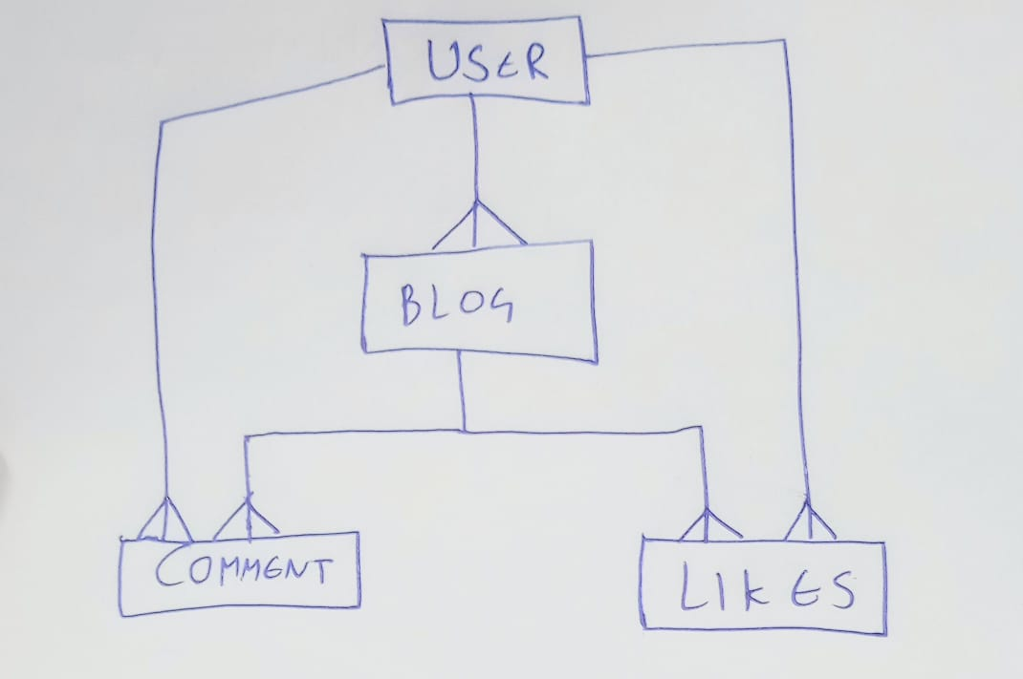
Database ER Diagram

Slide 5
Attributes for each table
User
User_id, Primary key
Name
Email
about
Password_hash
Date_creation
Is_admin
Blog
Blog_id, primary Key
User_id ,Foreign Key
Title
Body
Date created
Hate_flag
Comment
Comment_id, primary Key
User_id, Foreign Key
Blog_id, Foreign Key
Comment_text
Date_created
Hate_flag
Likes
Like_id, primary Key
User_id, foreign key
Blog_id, Foreign Key
Date_created

Slide 6
Types of users
Viewer
Doesn’t need to login to view
Can read articles and view author pages
Can’t like, comment or read blogs
Author
Can write, edit and delete their OWN blog posts
Can flag comments as hateful
Admin
Can delete comments and posts by other users
Can remove and update information for an existing user

Slide 7
Upcoming Steps
Create routes for all the pages
Login, registration, user profiles
Create APIs for creating and modifying
Create, Update and delete database objects
Models for database mapping
User, Blog, Comment, Like

